Slide 1
A Utility-aware Visual Approach for Anonymizing Multi-attribute Tabular Data
Presentation By: Matthew Luker Research Paper By: Xumeng Wang, Jia-Kai Chou, Wei Chen, Huihua Guan, Wenlong Chen, Tianyi Lao, Kwan-Liu Ma

Slide 2


Problem the Paper is Addressing
In today’s world, people are becoming more and more aware of the need to keep their data private
Companies like Google and Facebook want to utilize our data to build helpful resources, typically using multi-attribute tables
Can they build these resources without compromising our privacy?

Slide 3

Problem the Paper is Addressing
What is utility?
The ability in conveying useful information
The paper focuses on preserving the “utility” or rather, usability of data which is collected from a set of users or customers
By only focusing on the relevant pieces of information from a dataset, we can anonymize the information so that privacy is preserved
The most difficult part is the more we make the data anonymous, the less utility it holds
Other studies have developed methods to increase privacy preservation but don’t give lots of information about utility preservation

Slide 4

Methods
Rather than using an automated system which processes data without expert interaction, we can use visualizations
Visualizations allow for explanation of decisions, integration of expert knowledge, and the ability for more customization
As the user sanitizes the data, they can keep track of the utility of the remaining data.
Example: Analysis of medical records
Simply removing the individual’s name from the record is not sufficient, as they may be identified by defining characteristics
Using patient data to improve diagnosis or treatment may help the larger community, but we must not put those patients information at risk

Slide 5
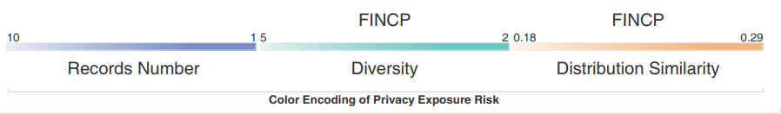
Methods
Diversity as seen as a visual encoding in the finalized tool
Strategies:
Remove unrelated attributes
Divide useful attributes into groups to obtain:
K-anonymity: We want K number of data values per attribute
L-diversity: We want L diverse values per attribute
T-closeness: Sensitive attributes should have distance T between group and entire dataset
Differential Privacy Model:
Add random noise to attribute values while preserving entire distribution
These strategies make it hard for those viewing the results to be able to come to conclusions about the more sensitive details of the original data

Slide 6
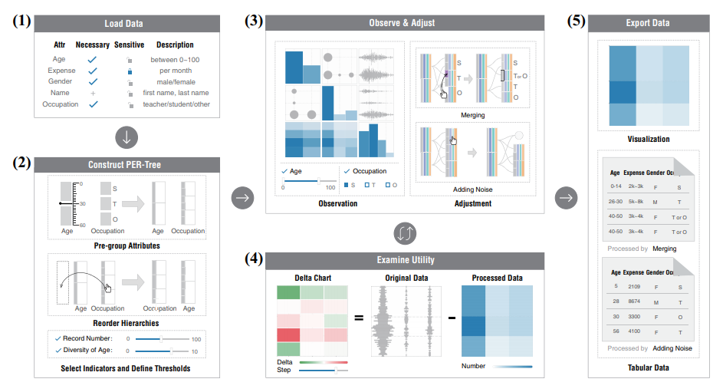
Methods
(3) Utility Preservation Degree Matrix
Provides visualization showing the amount of utility preserved
(2) PER-Tree: Privacy Exposure Risk Tree
Locate sources of private data and areas of concern

Slide 7
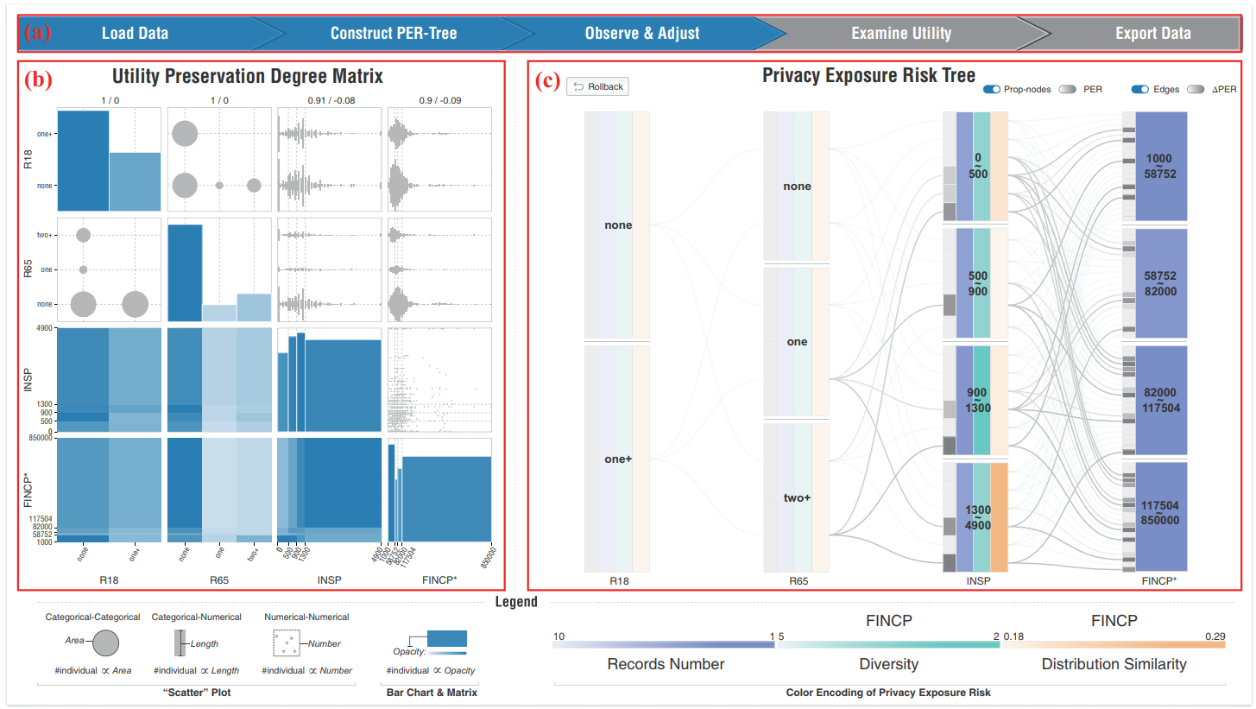
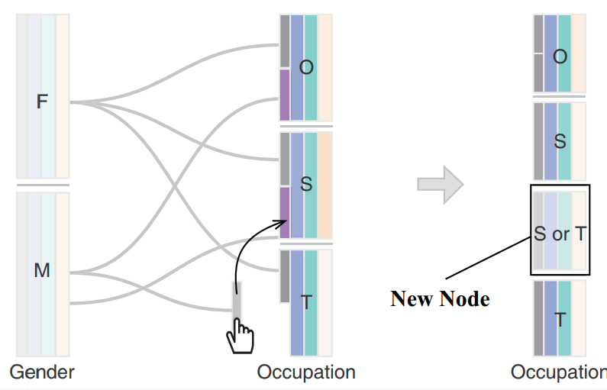
Results
VAST Tool
The result of this research was the creation of an interactive tool
This tool allows users to interact easily with their data
Users are able to directly view how the manipulation of data can impact both privacy and utility
Users are able to use two main strategies:
Adding noise to dataset
Once satisfied with the baseline dataset, users can begin to interact more experimentally with merging
Merging Data
Users are able to merge attributes which appear on the same level of the PER-Tree
The node merging operation

Slide 8
Results
Connections in tree show us the source of the privacy exposures

Slide 9

Conclusions
Issues:
Less experienced users may struggle to make meaningful decisions
The tool is more geared toward experts, giving lots of flexibility
It is very difficult to get an accurate measurement of utility due to some factors:
Inability to calculate utility for individual points because this would expose privacy
It is difficult to predict real world potential for the use of resulting datasets
A greater number of attributes in the PER-Tree leads to significant increase in the number of possible combinations of attributes
This leads to a lot more work upfront for the user
The tool will excel with smaller datasets because it means less work for the user

Slide 10
Works Cited
Wang, Xumeng & Chou, Jia-Kai & Chen, Wei & Guan, Huihua & Chen, Wenlong & Lao, Tianyi & Ma, Kwan-Liu. (2017). A Utility-Aware Visual Approach for Anonymizing Multi-Attribute Tabular Data. IEEE Transactions on Visualization and Computer Graphics. PP. 1-1. 10.1109/TVCG.2017.2745139.

